Slide 1
Methods for 2D and 3D femur segmentation
Francesco Pivi, Matteo Fusconi, Ospedale Rizzoli

Slide 2
Objectives
Explore currently available techniques for femur segmentation.
Enhance currently femur processing over the private Rizzoli dataset.
Reduce computational costs.

Slide 3
Abstract
2D and 3D segmentation fundamentals to help doctors for diagnosis.
2D femur segmentation:
  Unet and Resnet50.
  Unet and Resnet34.
  Unet and Deeplabv3.
  Unet++ and ResNet50.
  Unet++ and Resnet34 ( best model for segment the heads)
  Unet++ and Deeplabv3 (best model for segmet all femur).
3D femur segmentation:
  Total segmentator.
  Total segmentator fine tuned.

Slide 4
Introduction
Purpose:
  Improve 3D femur segmentation from CT images.
Segmentation techniques:
  Pixel-based, edge-based, region-based, model-based.
  Supervised: neural networks and transfer learning.
Methods compared:
  TotalSegmentator, Unet, Unet++.
  Backbones: Resnet34, ResNet50, Deeplabv3.
Goals:
  Find the best model for segmentation accuracy and efficiency.
  Measure of the performances via Dice score, Miou, Volume similarity and hardware costs.

Slide 5


Background
2D image segmentation:
  p : function learned by the model
  c : category of the pixel
  u,v : x, y pixel coordinates.
3D image segmentation:
  I : function learned by the model.
  c : category of the pixel.
  u,v : x,y position of the pixel.

Slide 6
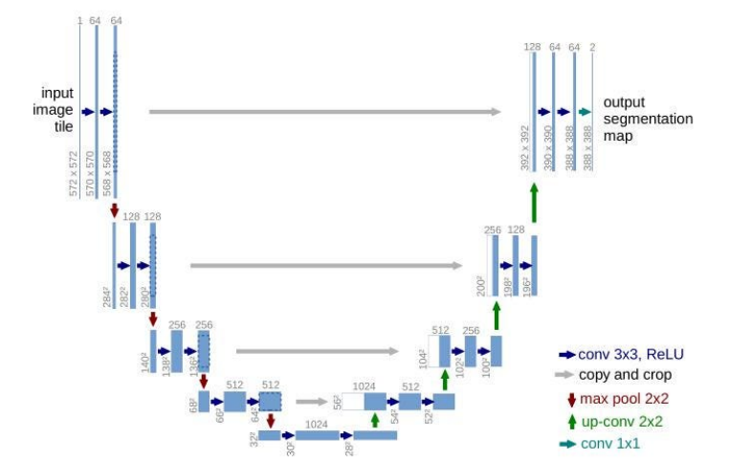
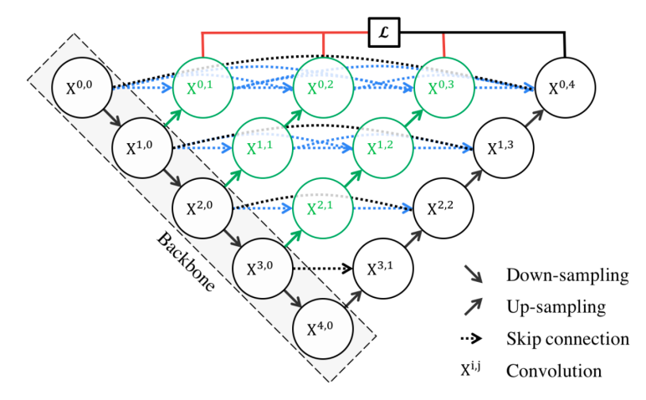
Architectures: 2D backbones
Unet
Unet++

Slide 7
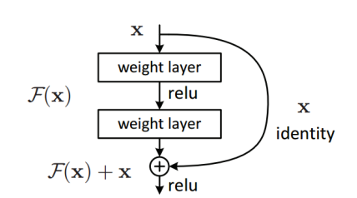
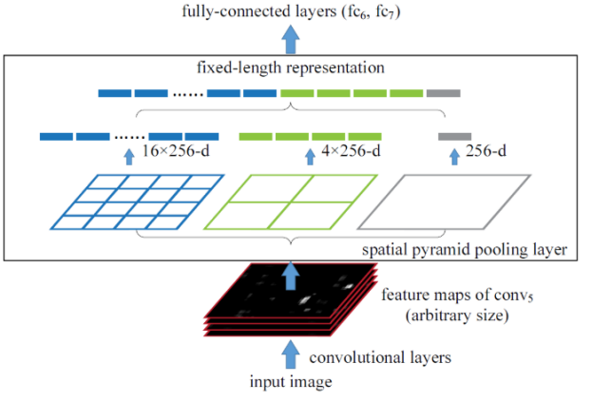
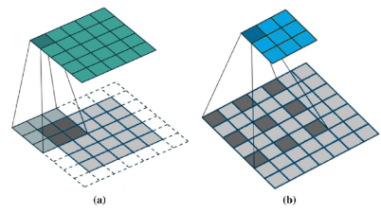
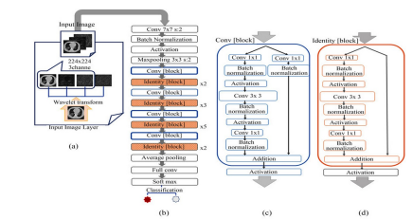
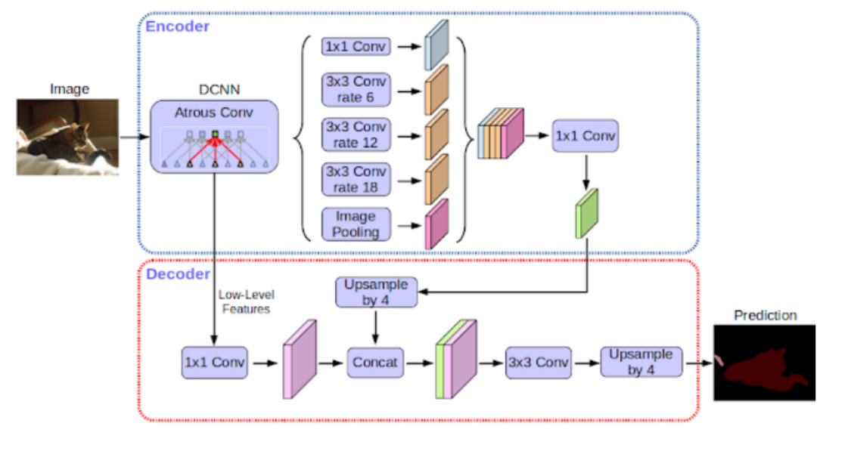
Architectures: encoders
Resnet34
Resnet50
Deeplabv3

Slide 8
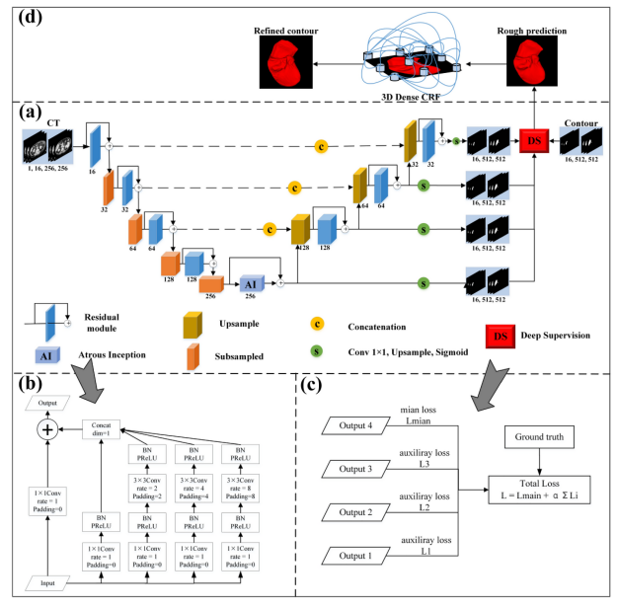
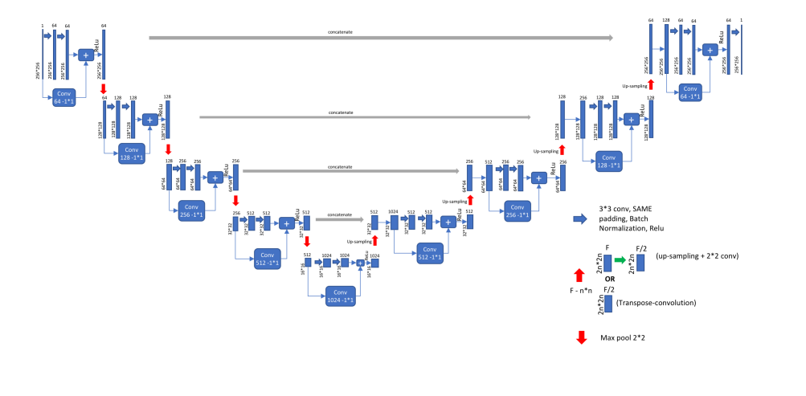
Architectural results
Backbone Unet/Unet++
Encoder Resnet.
Backbone Unet/Unet++
Encoder Deeplabv3

Slide 9
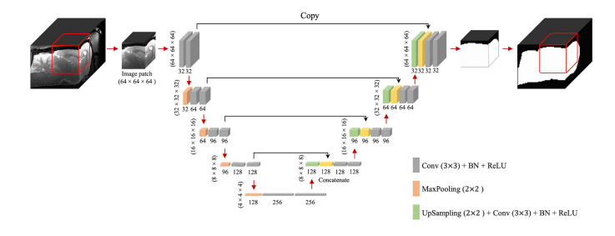
Architectures: 3D
TotalSegmentator: nnUnet architecture.

Slide 10
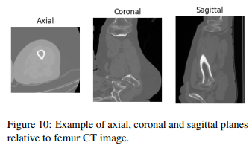
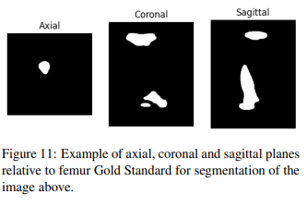
Data: General structure
40 3D images with gold standard from Ospedale Rizzoli (NRRD).
SimpleITK library to load them as numpy arrays.
24 images for train, 8 for validation, 8 for test.

Slide 11
Data: 2D
3D CT images converted to 2D slices for Axial, Sagittal and Coronal planes.
SimpleITK to load, slice and convert them as numpy arrays.
Stored them in a PyTorch dataloader with batch size 16.
Resampled the images at 256 x 256 resolution.
Relatively to femur’s heads we considered axial slicing.
Rescaled background added from -3000 to -1200 before scaling.
No data augmentation due to Google Colab Ram limits and training time time-out.

Slide 12
Data: 3D
Default pipeline of TotalSegmentator (taken by nnUnetv2).
Preprocessing:
  Cropping.
  Resampling.
  Clipping.
Data augmentation done automatically by TotalSegmentator:
  Random rotations, random scaling, random elastic deformations, gamma correction augmentation and mirroring.
5-folds stratified cross validation.

Slide 13
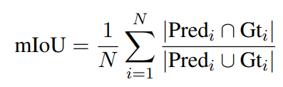
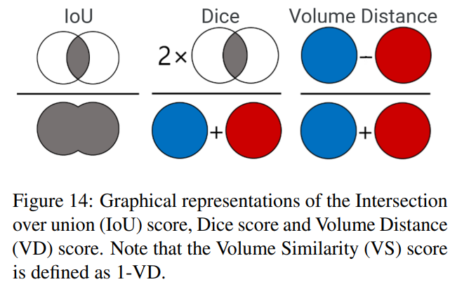


Metrics
mIou (2D and 3D):
Dice (2D and 3D):
Volume similarity:
  Where VD is the ratio of differences of volumes and their sum.

Slide 14
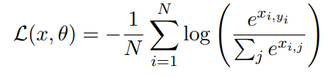
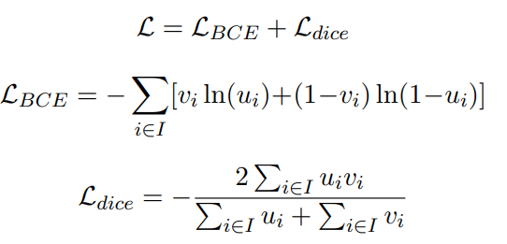
Losses
2D models
Crossentropy:
  N number of samples in a batch.
  x input tensor.
  y ground truth class.
  ❑ parameters of the model.
3D models
nnUnetv2 loss:
  Combination of Crossentropy and dice score based loss.

Slide 15
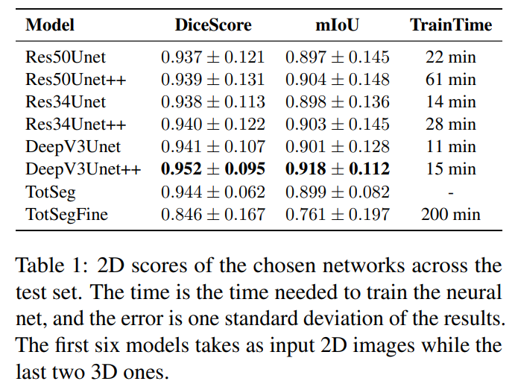
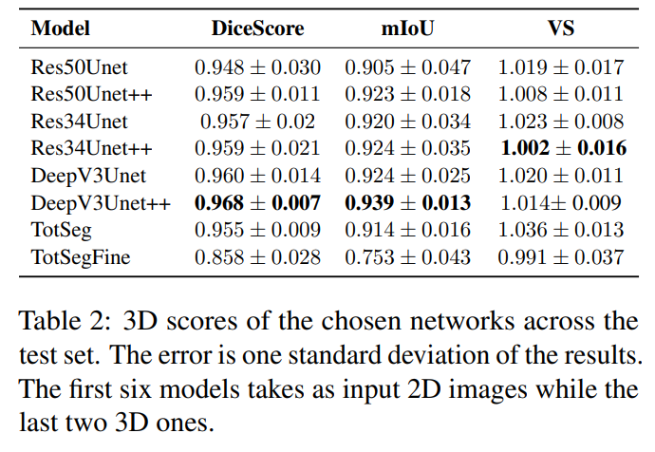
Results: full femur

Slide 16
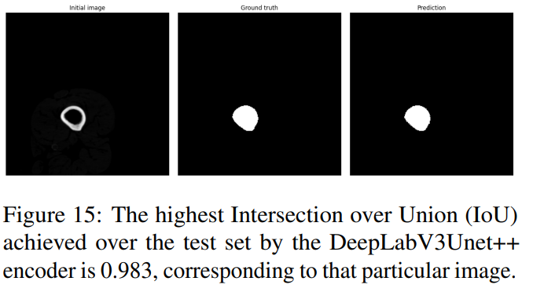
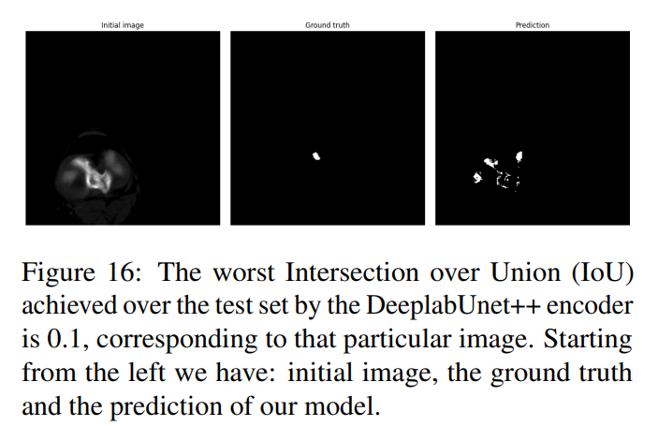
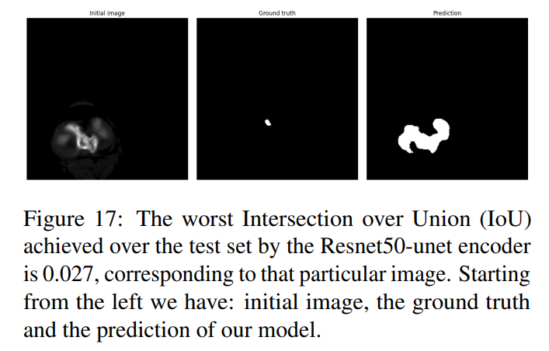
Results: full femur
Almost perfect segmentation in the central part of the femur.
Difficulties in segmenting the femur’s head.

Slide 17
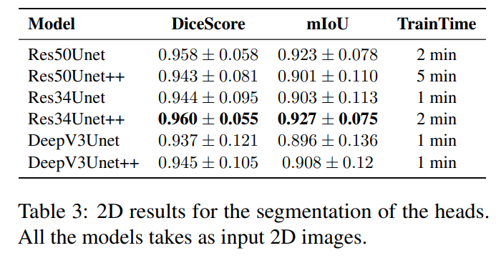
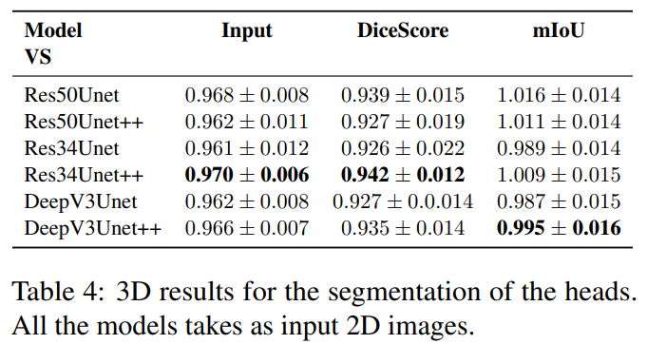
Results: Femur’s head

Slide 18
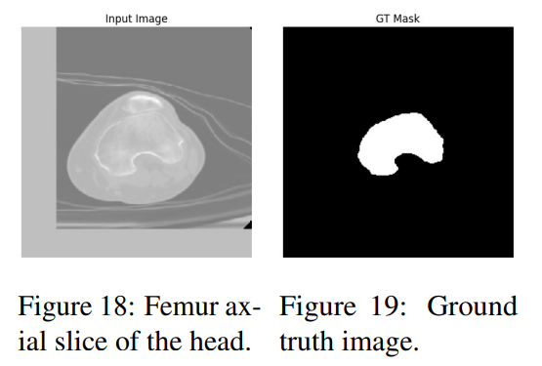
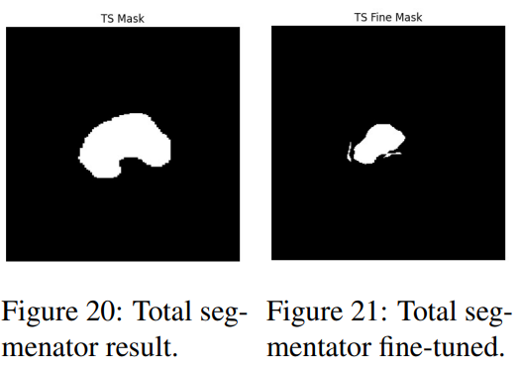
Results: Femur’s head

Slide 19
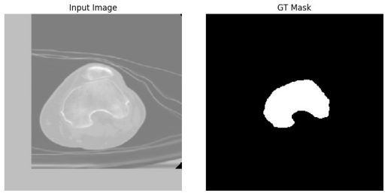
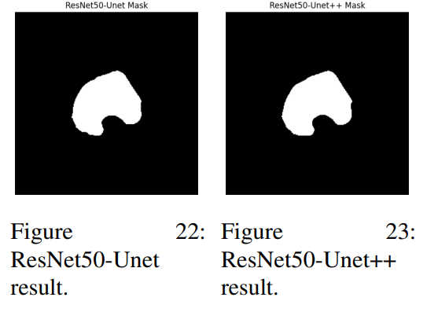
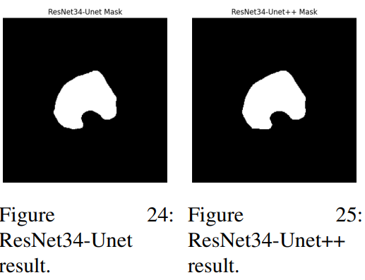
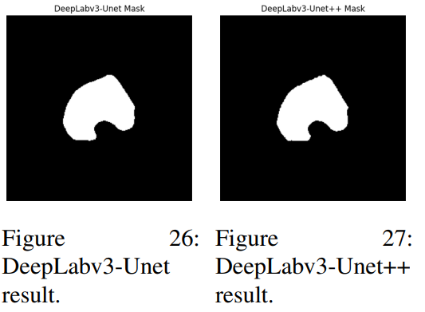
Results: femur’s head

Slide 20
Results: Further improvements
More extensive parameter tuning.
Better hardware for augmentation on 2D models.
More training images to better train nnUnet for this specific task.

Slide 21
Conclusion
Effective Models: Both 3D and 2D UNet models addressed segmentation effectively.
Challenge: Limited dataset size hindered effective 3D network training.
Best Performance:
  DeepLabV3-UNet++ outperformed other architectures and pretrained TotalSegmentator.
  Resnet-Unet++ if trained over heads resulted in the best model.
Future Potential: Larger dataset and computational resources could enable superior 3D nnUNet performance.

Slide 22
Thanks for the attention

Slide 23
Appendix

Slide 24
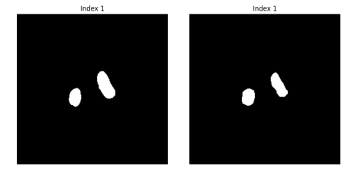
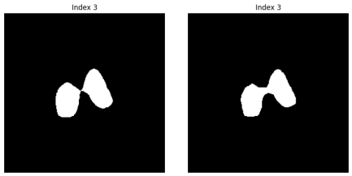
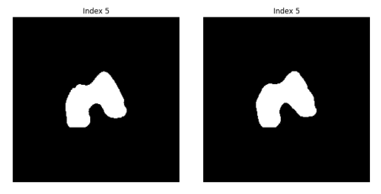
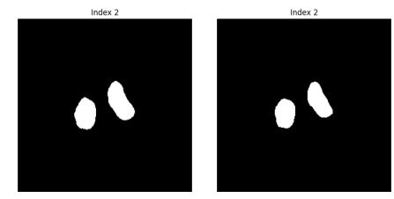
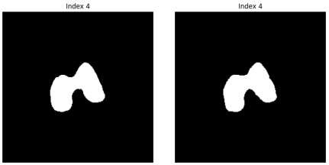
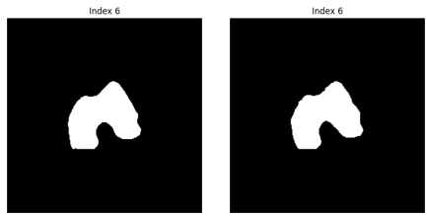
Femur head segmentation: last femur

Slide 25

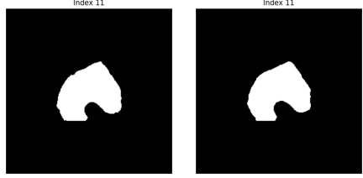
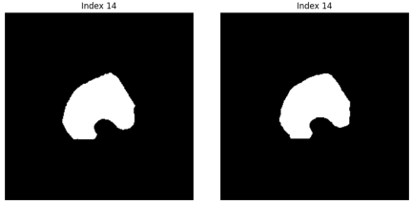
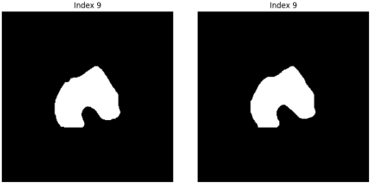
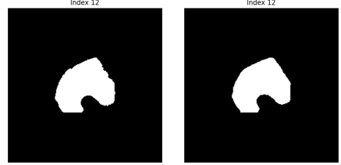
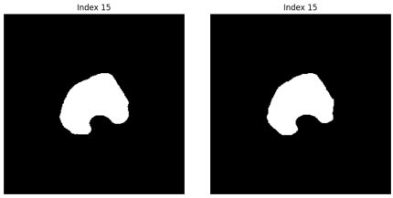
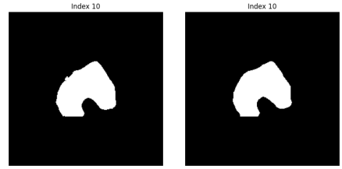
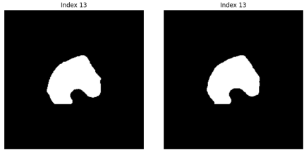
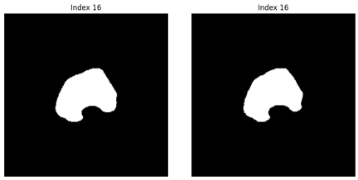

Slide 26
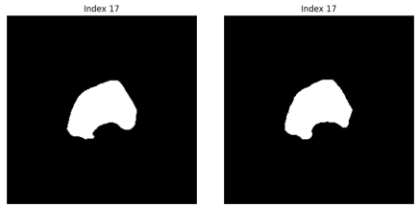
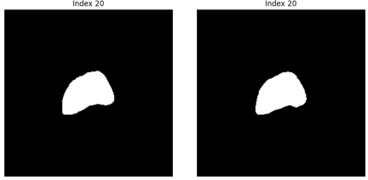
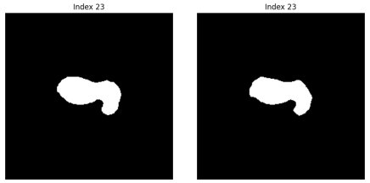
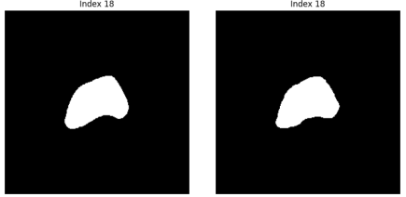
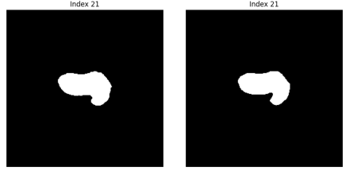
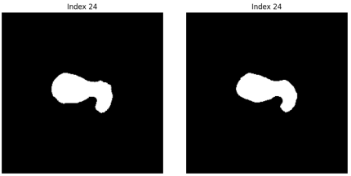

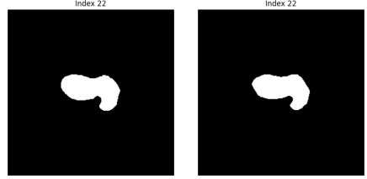


Slide 27










Slide 28







